Slide 1
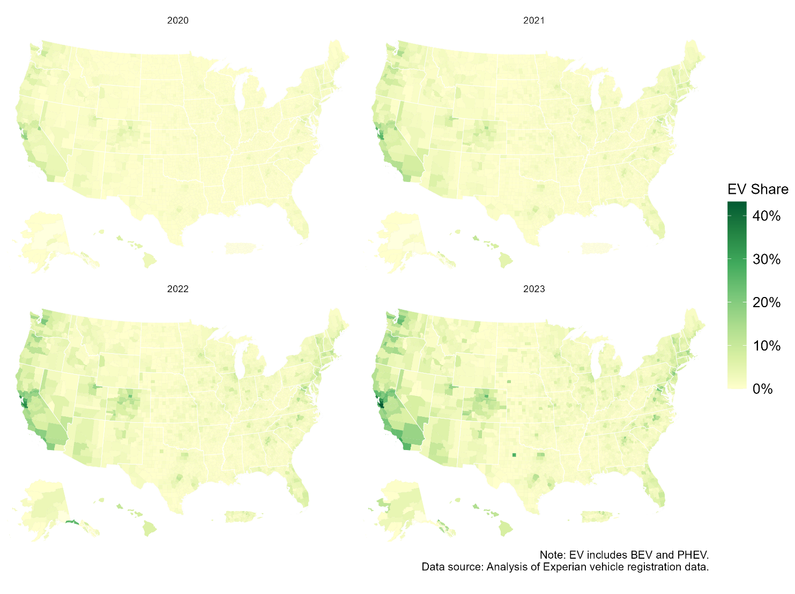
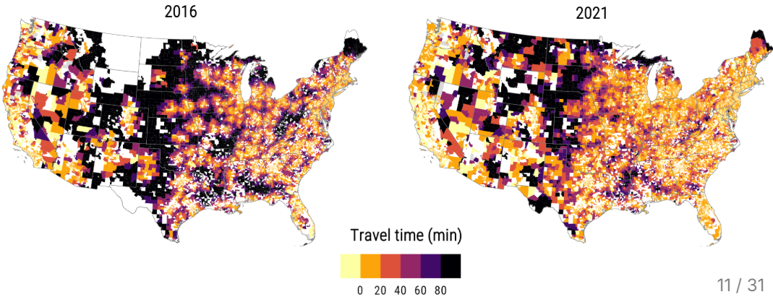
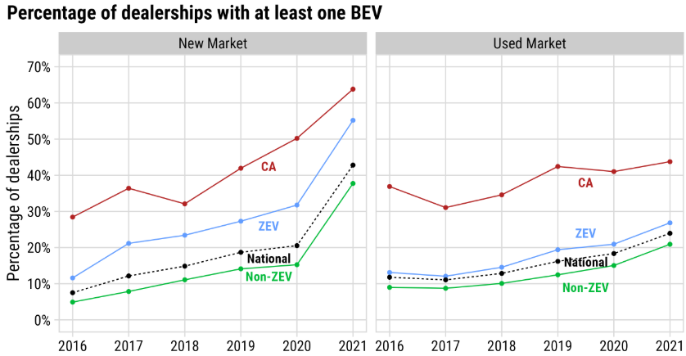
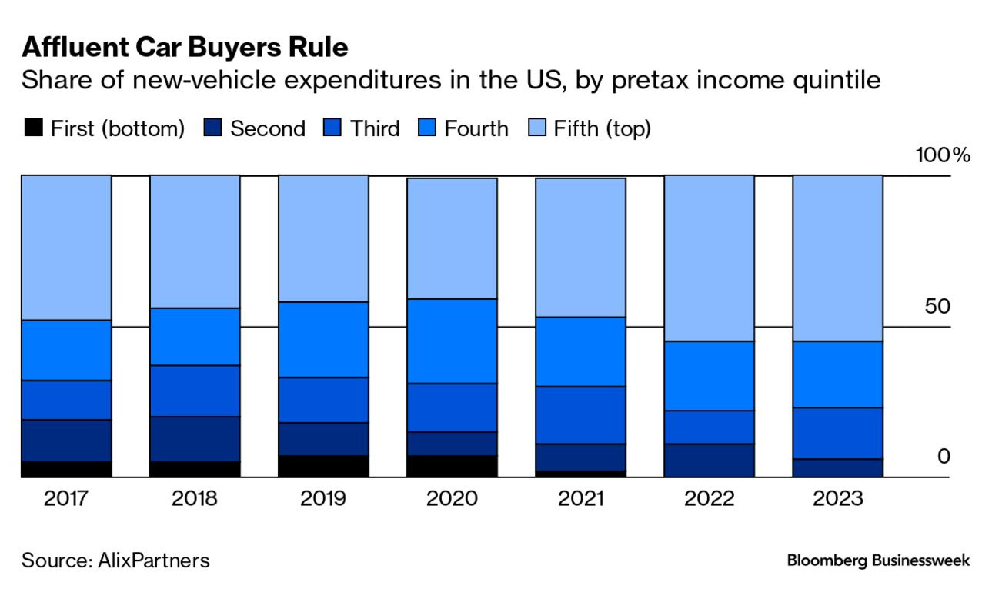
Tracking EVs Everywhere
NAME(S) | Arthur Yip
EMAIL | Arthur.Yip@nrel.gov
ORGANIZATION | NREL (Potential collaborators: J. Helveston, GWU; M. Taylor, LBNL; Gohlke/Zhou, ANL)
PROJECT TITLE | Tracking EVs Everywhere: State of Local EV Markets Nationwide, and Implications for Affordability, Accessibility, Equity
PROPOSED KEY RESULTS
Dashboard and/or regular reports, with dynamic visualizations showing spatial and temporal trends in PEV adoption, availability, and affordability Data resolution: Geographic: county or zipcode, & urbanity type via density/classification Demographics: income, housing type Vehicle: new/used, class/segment, price category, powertrain Temporal coverage: quarterly updates (lagged by 1-2 quarters), with 10+ years of history Metrics: Sales and stock shares, vehicle turnover, age, migration Price distributions and affordability indices Make-model availability/introductions/discontinuations at dealerships/localities New and used EV accessibility measured by travel time to available EV at dealer Visualizations: Choropleths (geographic heat maps) of EV adoption, affordability, and availability Recent trends with historical context Specific examples: - Adoption of EVs by locality and demographics e.g. EV purchase and ownership rates for low-income apartment-dwellers in zipcode 12345 (Implications on possible reliance on public charging) - Affordability and availability of EVs specific to locality or rurality e.g. prices and availability of used pickup trucks (ICEV vs. EV) in zipcode 12345 - In each zip-code/county, and by demographic, how much is being spent on (new or used) cars, informed by locality and demographics based on vehicle make-model-years. - Current EV sales at X%, Y level of availability, Z affordability lead to A% EV stock, B level of disparity, C cost burden - Where are EVs sold vs. ending up? How are used EVs migrating across the U.S.?
GOALS/OBJECTIVES OF THE PROJECT (50 words max)
Disseminate quantitative metrics and summary statistics that is open-access, reliable, best-available, frequently updated (e.g. monthly or quarterly), transparently and replicably generated, regarding the state of EV markets (new and used) across the entire US at high spatial resolution (e.g. county or zipcode) Provide standardized up-to-date baseline market data to enhance modeling, analysis, projections, and research, and also support local community planning As EV market evolves rapidly, inform potential for and barriers to EV adoption and access, for local community planning, modeling, policy making Expose existing EV market disparities in access and adoption, by deriving and disseminating high-resolution, standardized data Provide up-to-date insight on local revealed preferences, patterns, and factors of EV adoption, enabling tracking of progress on EV deserts in rural areas, for example. Transportation energy cost burden, adoption potential and barriers Inform community planners, modelers, analysts, policymakers, manufacturers, consumers
METHODOLOGICAL APPROACHES (e.g. survey data, new or existing model, etc.) (70 words max)
Fuse proprietary and semi-private big data (Experian registration matched with demographics & marketcheck dealership vehicle listings) Design desired metrics of new and used EV market adoption, access, availability, affordability, equity, derive reproducibly and at high resolution, and disseminate at high frequency (quarterly) Collect/model local electric & fuel costs, incl. EVSE & soft costs, specific to type/power/use cases Collect/infer data on dealer factors (interviews and/or ML on listings): EV exposure, staff training, marketing/messaging, consumer targeting, sales and maintenance margins, incentives Extend to analyses of charging access and cost burden, other factors critical to EV market evolution
MEASUREMENTS OF SUCCESS (70 words max)
Data access by local communities, non-profits, small organizations, and all DOE researchers, modelers, analysts Authoritative - Development of reproducible metrics for tracking EV market evolution - Dashboard and reports cited by stakeholders - Establishment of a public-facing dashboard for real-time market tracking - Integration of findings into policy discussions and industry planning Media coverage and stakeholder engagement with annual reports Enhancement and replacement of closed-access sources such as Alliance for Automotive Innovation dashboard, Bloomberg Publicly accessible resource, number of hits and downloads, positive value assessment and reviews from peer researchers/modelers/analysts Similar products: Tracking the Sun (solar), T-ATB, EPA Automotive Trends, AFDC, ANL Monthly LDV Sales Updates, Alliance for Automotive Innovation Dashboard/quarterly report, Atlas Public Policy EV Hub Proposed advances: used market data, open-source/access, frequent updates, high spatial and temporal resolution, as detailed as licenses will allow, standardized metrics relevant to DOE
Notes:
As the EV market expands beyond early adopters, there is a need to understand EV proliferation and where new and used EV are available, affordable, and adopted, across the US, at a fine spatial and demographic resolution and with up-to-date data. This project would fuse several proprietary data sources on vehicle markets to produce a publicly available, high-resolution, frequently updated dataset for modelers and analysts. Key metrics include sales shares, stock shares, turnover, age, dealership access, make-model availability, prices/depreciation, estimated vehicle expenditures, providing up-to-date insight on hyper-local vehicle preferences and adoption patterns. Rural/EV deserts of particular focus.
The project will further look into trends and correlations of where and how the EVs (and EVSEs) are getting adopted (and deployed) geographically and demographically.

